Slide 1
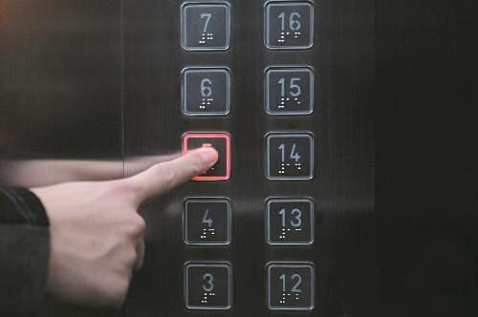
电梯偶遇

Slide 2
Reading for basic information
a woman
two men
who
where
when
strangers
her husband
in the lift of the hotel
on a weekend

Slide 3
Reading for structure
On a weekend, a woman won a big bag of coins at a game machine. She took a break for dinner with her husband in the hotel dining room. But first she wanted to put the coins in her room.
“I'll be right back and we'll go to eat," she told her husband. Then she carried the bag to the lift. As she was about to walk into the lift she noticed two men already aboard.
Both were huge, very huge figures. The woman was scared. Her first thought was: ＂These two are going to rob me.” Her next thought was: “Don't be afraid. They look like nice gentlemen.”
But fear seized her. She stood and stared at the two men. She felt anxious and ashamed. She hoped they didn't read her mind. Surely they knew her hesitation about joining them in the lift. It was all too obvious. Her face was red. She couldn't just stand there, so with an effort of will she picked up one foot and stepped forward and followed with the other foot and was on the lift. Avoiding eye contact, she turned around and faced the lift doors as they closed.
A second passed, and then another second, and then another. Her fear increased! The lift didn't move. Panic consumed her. “Oh dear," she thought, “I'm about to be robbed!”
Her heart sank and sweat poured. Then one of the men said, “Hit the floor.” Instinct (本能） told her: Do what they tell you. The bag of coins flew upwards as she threw out her arms and collapsed on the lift carpet. A shower of coins rained down on her. “Take my money and spare me," she prayed. More seconds passed.
She heard one of the men say politely, "Madam, if you'll just tell us what floor you're going to, we'll push the button. "The one who said it had a little trouble getting the words out .He couldn't help laughing.

Slide 4
Reading for structure
On a weekend, a woman won a big bag of coins at a game machine. She took a break for dinner with her husband in the hotel dining room. But first she wanted to put the coins in her room.
“I'll be right back and we'll go to eat," she told her husband. Then she carried the bag to the lift. As she was about to walk into the lift she noticed two men already aboard.
Part1(1-2) background
The woman won a lot of money and took a lift to put it away in the room.

Slide 5
Both were huge, very huge figures. The woman was scared. Her first thought was: ＂These two are going to rob me.” Her next thought was: “Don't be afraid. They look like nice gentlemen.”
But fear seized her. She stood and stared at the two men. She felt anxious and ashamed. She hoped they didn't read her mind. Surely they knew her hesitation about joining them in the lift. It was all too obvious. Her face was red. She couldn't just stand there, so with an effort of will she picked up one foot and stepped forward and followed with the other foot and was on the lift. Avoiding eye contact, she turned around and faced the lift doors as they closed.
A second passed, and then another second, and then another. Her fear increased! The lift didn't move. Panic consumed her. “Oh dear," she thought, “I'm about to be robbed!”
Part1(3-6) development
the woman's racing thoughts(inner conflicts) about her money and the possible robbery of two big strangers in the lift.
Her heart sank and sweat poured. Then one of the men said, “Hit the floor.” Instinct
(本能） told her: Do what they tell you. The bag of coins flew upwards as she threw out her arms and collapsed on the lift carpet. A shower of coins rained down on her. “Take my money and spare me," she prayed. More seconds passed.

Slide 6
What did the woman think the two men would do?
Why did she think so?
The two men would rob her
(reasons)

Slide 7
Both were huge, very huge figures. The woman was scared. Her first thought was: ＂These two are going to rob me.” Her next thought was: “Don't be afraid. They look like nice gentlemen.”
But fear seized her. She stood and stared at the two men. She felt anxious and ashamed. She hoped they didn't read her mind. Surely they knew her hesitation about joining them in the lift. It was all too obvious. Her face was red. She couldn't just stand there, so with an effort of will she picked up one foot and stepped forward and followed with the other foot and was on the lift. Avoiding eye contact, she turned around and faced the lift doors as they closed.
A second passed, and then another second, and then another. Her fear increased! The lift didn't move. Panic consumed her. “Oh dear," she thought, “I'm about to be robbed!”
Her heart sank and sweat poured. Then one of the men said, “Hit the floor.” Instinct (本能） told her: Do what they tell you. The bag of coins flew upwards as she threw out her arms and collapsed on the lift carpet. A shower of coins rained down on her. “Take my money and spare me," she prayed. More seconds passed.

Slide 8
Both were huge, very huge figures. The woman was scared. Her first thought was: ＂These two are going to rob me.” Her next thought was: “Don't be afraid. They look like nice gentlemen.”
But fear seized her. She stood and stared at the two men. She felt anxious and ashamed. She hoped they didn't read her mind. Surely they knew her hesitation about joining them in the lift. It was all too obvious. Her face was red. She couldn't just stand there, so with an effort of will she picked up one foot and stepped forward and followed with the other foot and was on the lift. Avoiding eye contact, she turned around and faced the lift doors as they closed.
A second passed, and then another second, and then another. Her fear increased! The lift didn't move. Panic consumed her. “Oh dear," she thought, “I'm about to be robbed!”
Her heart sank and sweat poured. Then one of the men said, “Hit the floor.” Instinct (本能） told her: Do what they tell you. The bag of coins flew upwards as she threw out her arms and collapsed on the lift carpet. A shower of coins rained down on her. “Take my money and spare me," she prayed. More seconds passed.

Slide 9
What did the woman think the two men would do?
Why did she think so?
She carried a bag of coins alone
The two men were huge, very huge figures
The two men would rob her
(reasons)
The lift didn't move after being there for
several seconds
“hit the floor”

Slide 10
How did the woman feel generally ? How do you know that?
fear

Slide 11
Both were huge, very huge figures. The woman was scared. Her first thought was: ＂These two are going to rob me.” Her next thought was: “Don't be afraid. They look like nice gentlemen.”
But fear seized her. She stood and stared at the two men. She felt anxious and ashamed. She hoped they didn't read her mind. Surely they knew her hesitation about joining them in the lift. It was all too obvious. Her face was red. She couldn't just stand there, so with an effort of will she picked up one foot and stepped forward and followed with the other foot and was on the lift. Avoiding eye contact, she turned around and faced the lift doors as they closed.
A second passed, and then another second, and then another. Her fear increased! The lift didn't move. Panic consumed her. “Oh dear," she thought, “I'm about to be robbed!”
Her heart sank and sweat poured. Then one of the men said, “Hit the floor.” Instinct
(本能） told her: Do what they tell you. The bag of coins flew upwards as she threw out her arms and collapsed on the lift carpet. A shower of coins rained down on her. “Take my money and spare me," she prayed. More seconds passed.

Slide 12
How did the woman feel generally ? How do you know that?
Both were huge, very huge figures. The woman was scared. Her first thought was: ＂These two are going to rob me.” Her next thought was: “Don't be afraid. They look like nice gentlemen.”
But fear seized her. She stood and stared at the two men. She felt anxious and ashamed. She hoped they didn't read her mind. Surely they knew her hesitation about joining them in the lift. It was all too obvious. Her face was red. She couldn't just stand there, so with an effort of will she picked up one foot and stepped forward and followed with the other foot and was on the lift. Avoiding eye contact, she turned around and faced the lift doors as they closed.
A second passed, and then another second, and then another. Her fear increased! The lift didn't move. Panic consumed her. “Oh dear," she thought, “I'm about to be robbed!”
Her heart sank and sweat poured. Then one of the men said, “Hit the floor.” Instinct
(本能） told her: Do what they tell you. The bag of coins flew upwards as she threw out her arms and collapsed on the lift carpet. A shower of coins rained down on her. “Take my money and spare me," she prayed. More seconds passed.
direct ways to show “fear”

Slide 13
How did the woman feel generally ? How do you know that?
Both were huge, very huge figures. The woman was scared. Her first thought was: ＂These two are going to rob me.” Her next thought was: “Don't be afraid. They look like nice gentlemen.”
But fear seized her. She stood and stared at the two men. She felt anxious and ashamed. She hoped they didn't read her mind. Surely they knew her hesitation about joining them in the lift. It was all too obvious. Her face was red. She couldn't just stand there, so with an effort of will she picked up one foot and stepped forward and followed with the other foot and was on the lift. Avoiding eye contact, she turned around and faced the lift doors as they closed.
A second passed, and then another second, and then another. Her fear increased! The lift didn't move. Panic consumed her. “Oh dear," she thought, “I'm about to be robbed!”
Her heart sank and sweat poured. Then one of the men said, “Hit the floor.” Instinct
(本能） told her: Do what they tell you. The bag of coins flew upwards as she threw out her arms and collapsed on the lift carpet. A shower of coins rained down on her. “Take my money and spare me," she prayed. More seconds passed.
indirect ways to show “fear”

Slide 14
But fear seized her
with an effort of will
Avoiding eye contact
Her fear increased!
Her heart sank and sweat poured
Panic consumed her. “
“Take my money and spare me," she prayed.
Her heart sank and sweat poured. Then one of the men said, “Hit the floor.” Instinct (本能） told her: Do what they tell you. The bag of coins flew upwards as she threw out her arms and collapsed on the lift carpet. A shower of coins rained down on her. “Take my money and spare me," she prayed. More seconds passed.
What did the woman do?
Her fear became stronger and stronger

Slide 15
different understandings
about “Hit the floor”
Do you think the two men wanted to rob the woman?
What is your reason for that?
collapse on the floor
and give in(to them /give them
the monry
the woman
the two men
help to hit the button for her floor
The woman misunderstood the two men

Slide 16
Part 3 (7) climax
(The woman finally seemed to find what the two strangers really meant )
She heard one of the men say politely, "Madam, if you'll just tell us what floor you're going to, we'll push the button. "The one who said it had a little trouble getting the words out .He couldn't help laughing.

Slide 17
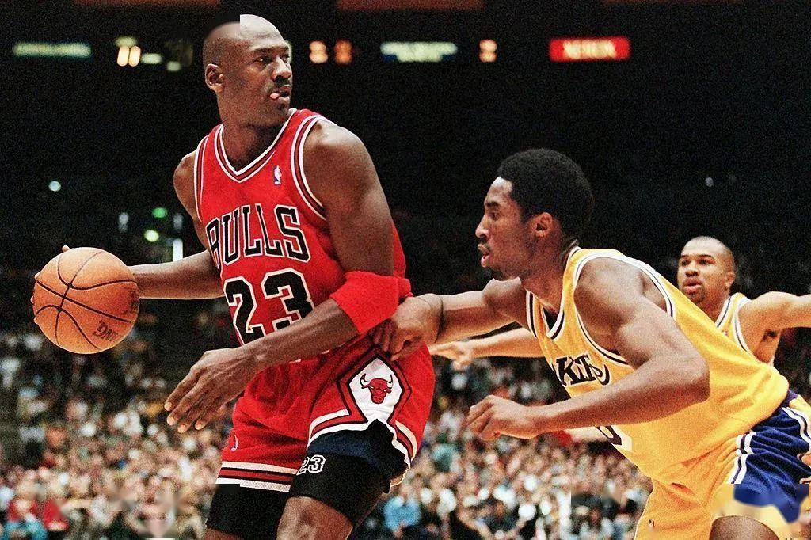

Eddie Murphy & Michael Jordan
艾迪·墨菲和迈克尔·乔丹
原来老太太遇到大明星了。虽然尴尬，不过也收获不小啊

Slide 18
Paragraph 1: She lifted her head and looked up at the two men.
How would she feel then?
(embarrassed,ashamed)
What would the woman and two men do?
(what about the coins on the ground? the woman still collapsed on the ground )
Paragraph 2: Then, the lift arrived at her floor.
What’s happening in Para1when the woman realized her misunderstanding?
What would she do then ? How would she feel?
(She felt relieved and amused about the funny story)
What’s the reflection?

Slide 19
Para1 She lifted her head and looked up at the two men
场景一：老妇人很尴尬
那人的话把她意识到，他们确实准备帮助她。（所想）
The man’s word jolted（使...震动）/brought her back into reality that they actually prepared to help her.
刹那间，她明白了那两个男人其实是想提醒她按楼层按钮（所想）
In a flash, it struck her that the two men actually meant to remind her to hit the button for her floor
她立刻涨红了脸，感到很尴尬（所感）
Blushing scarlet(鲜红的） instantly, she felt embarrassment almost wreathed/enveloped her entirely.
“很抱歉，”她在成堆的硬币中不知所措。（所说）
I’m sorry.’ she floundered（不知所错） in the piles of coins.

Slide 20
场景二：两个陌生人的帮助
他们耸了耸肩，咧着嘴笑，这就驱散了她的一切烦恼，给了她安慰。
They shrugged and grinned, which dissolved all her distress and consoled/ comforted her.
她急忙去检硬币，告诉他们她去5层
Scrambling to pick up the coins, she told them her floor 5.
两名男子按下按钮后，礼貌地跪下来把散落在电梯板上的硬币扫在一起。
The two men, after pressing the button, knelt down politely and swept the coins strewed/scattered the elevator board together.
场景三：老妇人的感激
“谢谢!” 她紧紧抓住袋子，充满了感激和温暖。
‘Thanks.’ Clinging her hands to the opening bag , she was overwhelmed by a surge of gratitude and warmth.

Slide 21
他们咬着嘴唇。显然，他们强忍着笑。
They bit their lips. It was obvious they were having a hard time
not laughing.

Slide 22
She lifted her head and looked at the two men. In a flash, she understood the two men actually meant to remind her to hit the button for her floor. She thought: "My God, what a spectacle（scene） I've made of myself(出了多大的洋相）." Feeling embarrassed and ashamed, she struggled to her feet. With her face bursting into flames, she wanted to blurt out an apology, but words failed her. How could you apologize to two perfectly respectable gentlemen for behaving as though they were going to rob you? She didn’t know what to say, just standing there stiffly. The two men contained their belly laugh（捧腹大笑） and helped her gather up the scattered coins.

Slide 23
Paragraph 2: Then, the lift arrived at her floor.
场景一：感谢
这两个陌生人无疑使她今天很愉快。
The two strangers undoubtedly lit her day up.
她停了下来，心中洋溢着欢快的心情，顶着两个男人惊讶的表情，拿出一把硬币，扭头把它们塞进他们的手里。
Brimming over with joy, she stopped, fished out (take out) a handful coins and turned around to squeeze/stuff them in their fists despite two men's astonished expression.
“谢谢你们!”她只能用硬币回报他们。
"Thank for your kindness! ' She could only reciprocate/reward them with the coins.
“这是我们的荣幸!”他俩笑着说
“It is our privilege!”they beamed.

Slide 24
场景二 告别
“夫人,再见!祝您度过一个愉快的夜晚!在她出来之前两名男子为她祝福。
"Madam, goodbye! Wish you a pleasant evening! "Before she stepped out, two men delivered their blessing.
她温柔地欣赏着这些巨大的身影，微笑着向它们挥手告
Gently appreciating the huge figures, she smiled and waved them bye.
场景三： 反思
晚餐前的这段不可思议的经历教会了她，永远不要以貌取人，对不认识的人怀有最大的善意。
The incredible experience before her dinner taught her that never judge one person depending on his appearance and extend/show the biggest kindness to people unknown.

Slide 25
Then, the lift arrived at her floor. Saying goodbye shyly, she stepped out of the lift hurriedly. She let out a sigh of relief, rushed into her room and threw herself onto the bed. Scooping up the coins, she couldn’t help roaring with laughter. After a while, she sprang out of bed and rushed downstairs for dinner. Over dinner, she shared the whole event with her husband, who laughed a lot and joked that the woman would never forget what “hit the floor” meant and never judge a book by its cover. What an amusing and unforgettable experience!

Slide 26
As she slipped into her room she could hear them roaring with laughter while they walked back to the elevator. The woman brushed herself off. She pulled herself together and went downstairs for dinner with her husband.
The next morning flowers were delivered to her room---a dozen roses. Attached to EACH rose was a crisp one hundred dollar bill. The card said: “Thanks for the best laugh we’ve had in years.” It was signed, Eddie Murphy & Michael Jordan.

Slide 27
未读懂文章，描写女主人公一直害怕到底。
未读懂前文,写成女主人公没有及时出电梯或开始捡硬币。
主题过度解读，以邀请两位男士吃饭，并成了好朋友结尾。

Slide 28
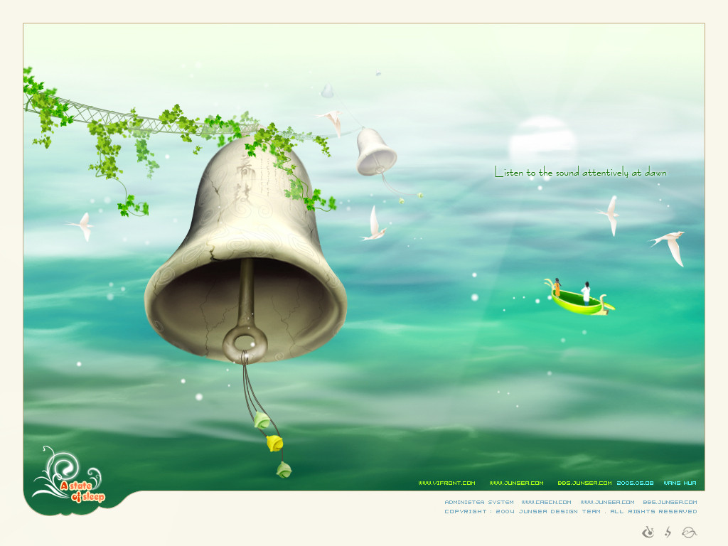
see you!

Slide 30
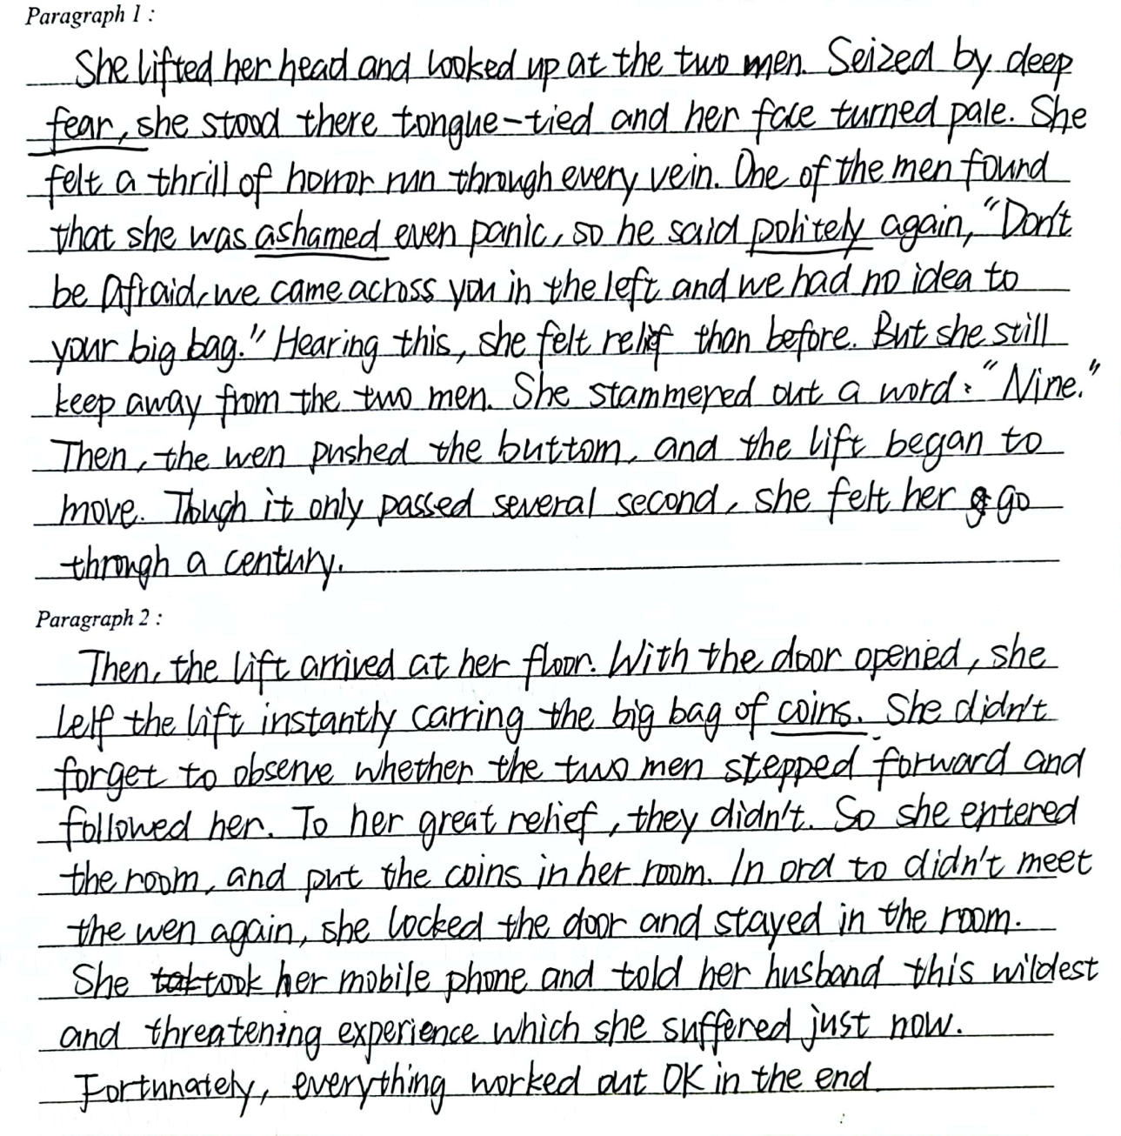
典型问题习作
未读懂文章，描写女主人公一直害怕到底。

Slide 31
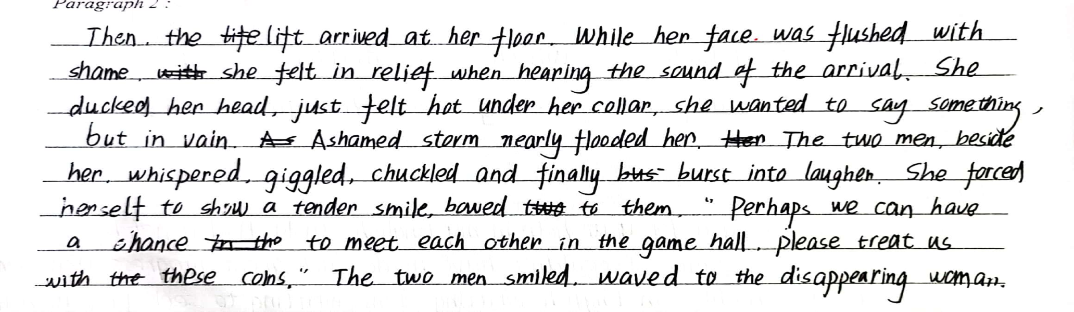
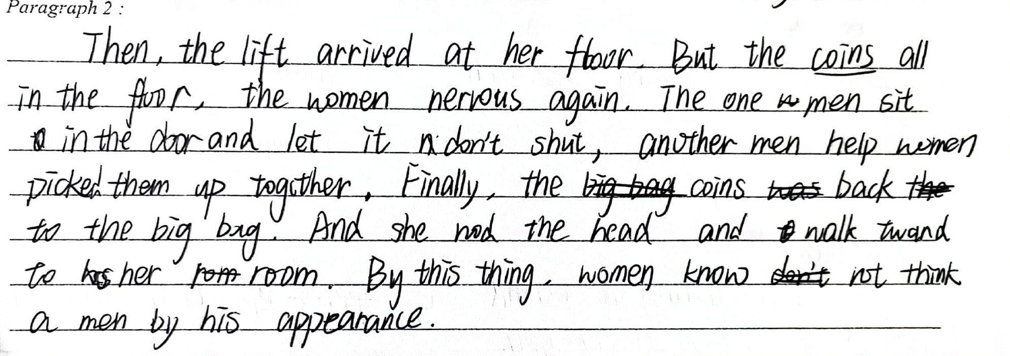
典型问题习作
未认真解读第二段首句,写成女主人公没有及时出电梯或开始捡硬币。

Slide 32
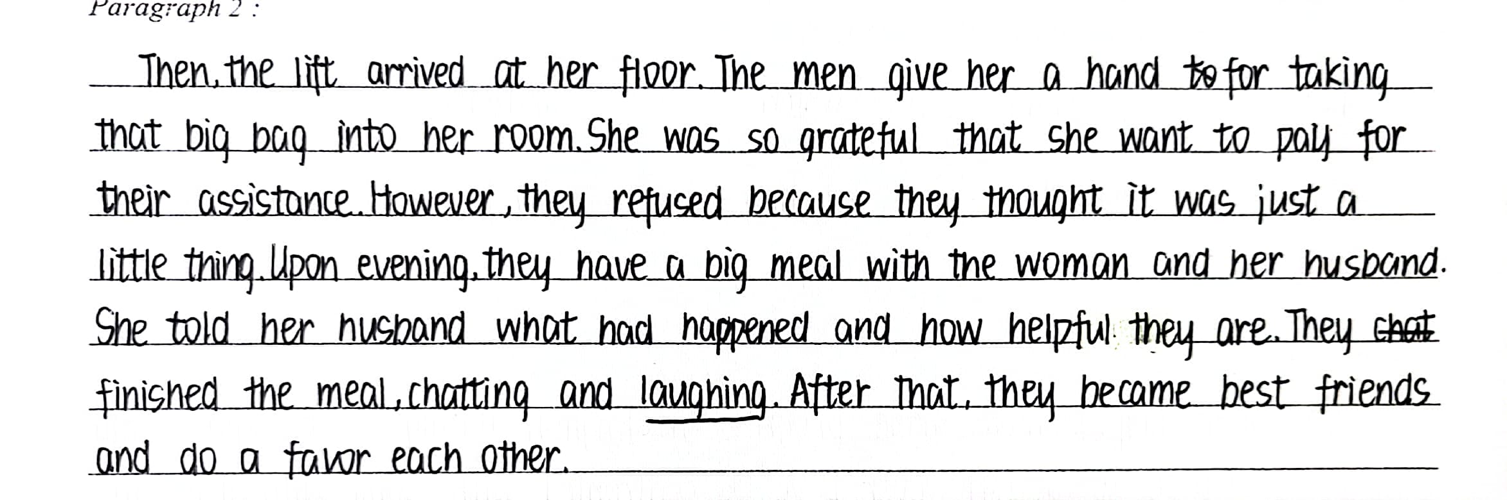
典型问题习作
主题过度解读，以
邀请两位男士吃饭，并成了好朋友结尾。

Slide 33
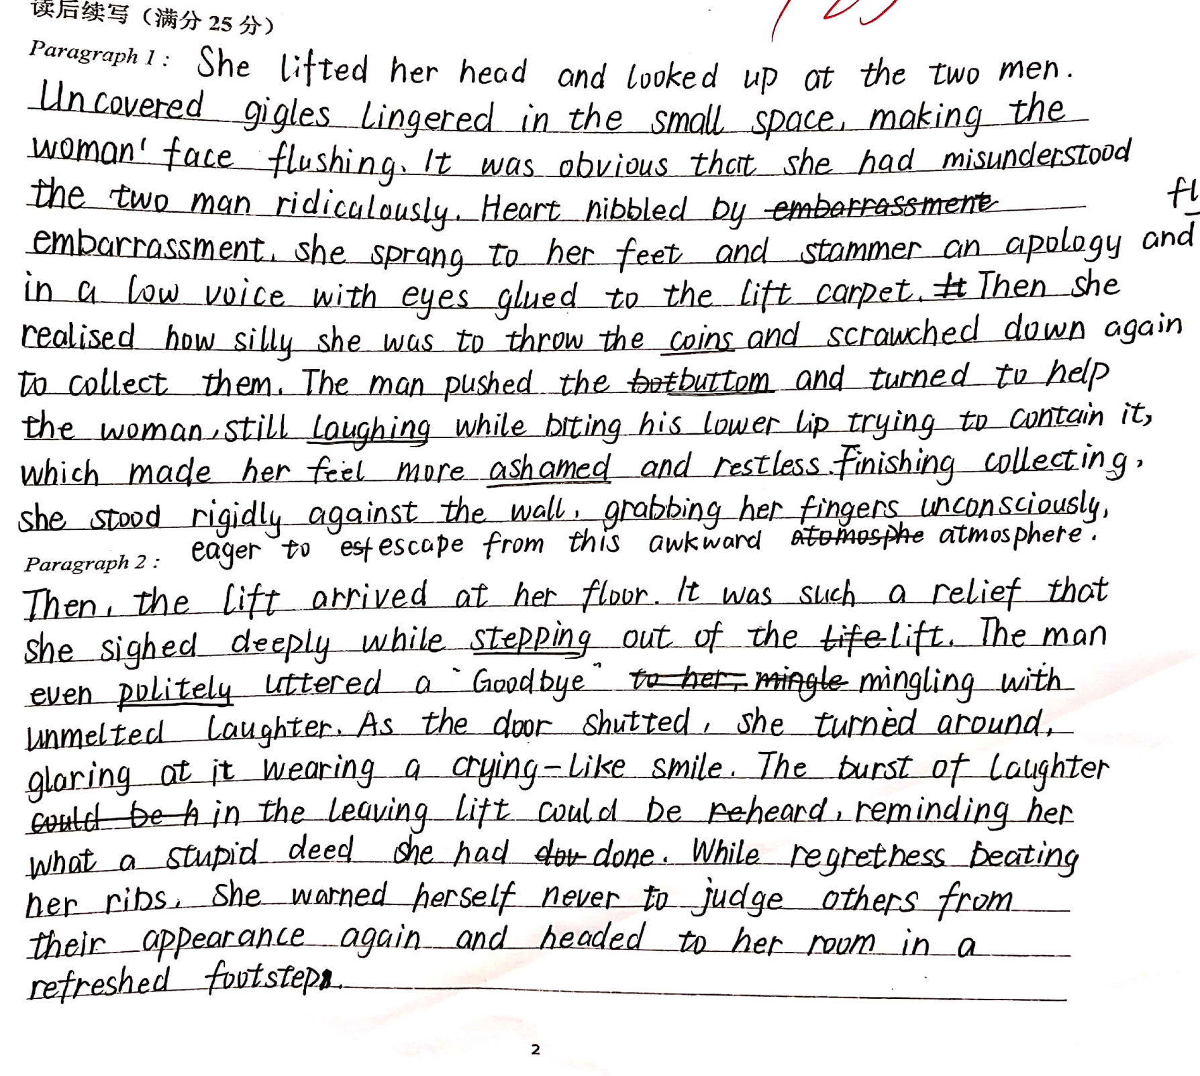
Appreciation
本文情节合理,逻辑清晰,与所给原文衔接度高。细腻的语言描写生动地展现了主人公先尴尬而后如释重负的心理活动。主题升华自然准确。

